Slide 1
Graph Neural Networks and Transformers Workshop
ENCCS and RISE
Erik Ylipää and Leon Sütfeld

Slide 2
Workshop Outline
Thursday October 21
Friday October 22
Thursday October 21
09:00 - 09:20 | Workshop intro
09:20 - 10:00 | Intro for session 1 notebooks: Graphs and what to do with them
10:00 - 12:00 | Work on notebooks
12:00 - 13:00 | Lunch break
13:00 - 13:30 | Intro for session 2 notebooks: From graphs to tensors
13:30 - 15:50 | Work on notebooks
15:50 - 16:00 | Recap of the day
09:00 - 09:30 | Intro to session 3, Inner workings of Graph Neural Networks
09:30 - 12:00 | Work on notebooks
12:00 - 13:00 | Lunch break
13:00 - 13:30 | Intro for session 4 notebooks: From GNNs to Transformers
13:30 - 15:40 | Work on notebooks
15:40 - 16:00 | Recap of the workshop

Slide 3
Outline of this presentation
Introduction to ENCCS and RISE
Workshop structure
Introduction to Graphs, Graph Neural Networks and Transformers

Slide 4

ENCCS - Director Lilit Axner

Slide 5
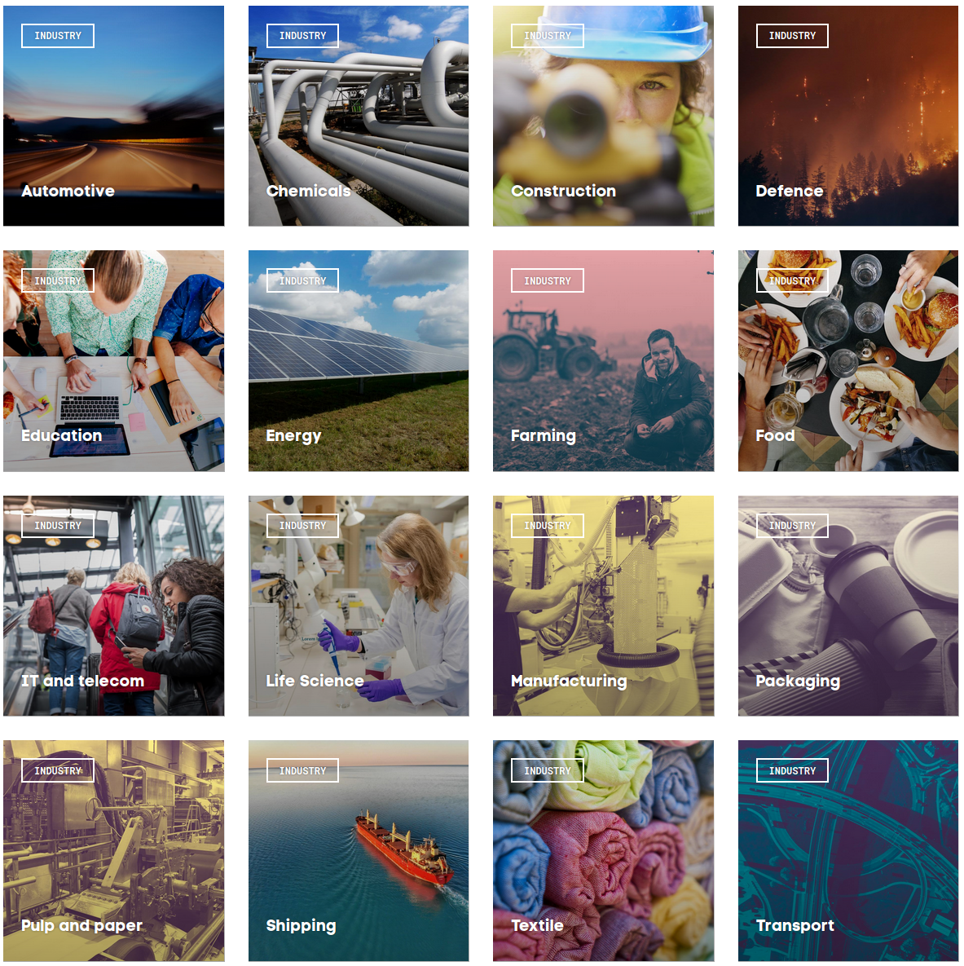
RISE
RESEARCH INSTITUTES OF SWEDEN
RISE’s mission is to work for sustainable growth in Sweden by strengthening the competitiveness and capacity for renewal of Swedish industry, as well as promoting the innovative development of society as a whole.
In January 2021 RISE had approximately 2 800 employees over five organisational divisions:
Bioeconomy and Health
Materials and Production
Digital systems
Built Environment
Safety and Transport
RISE operates in more than 25 cities all over Sweden and also have facilities in Denmark, Norway, Great Britain, France and Belgium.

Slide 6
The Workshop

Slide 7
The goal of this workshop is to show the workings of Graph Neural Networks in detail,
and how Transformers work almost the same.
We want to give you a deep understanding of these architectures so you can tailor them to your problem

Slide 8
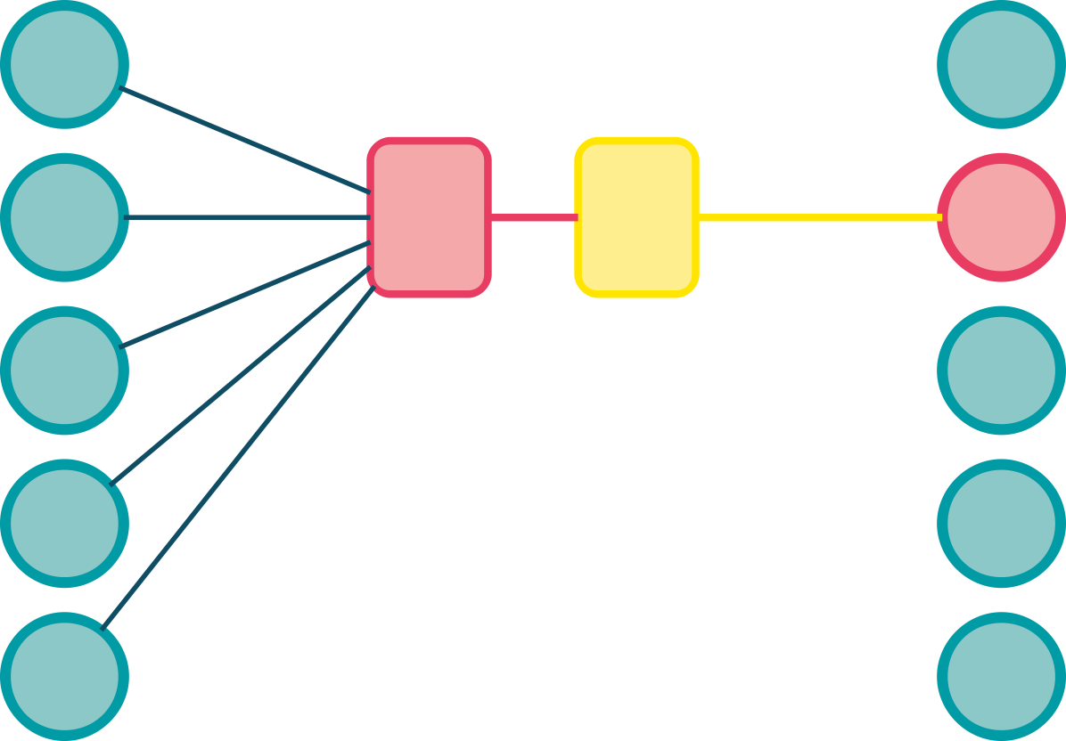
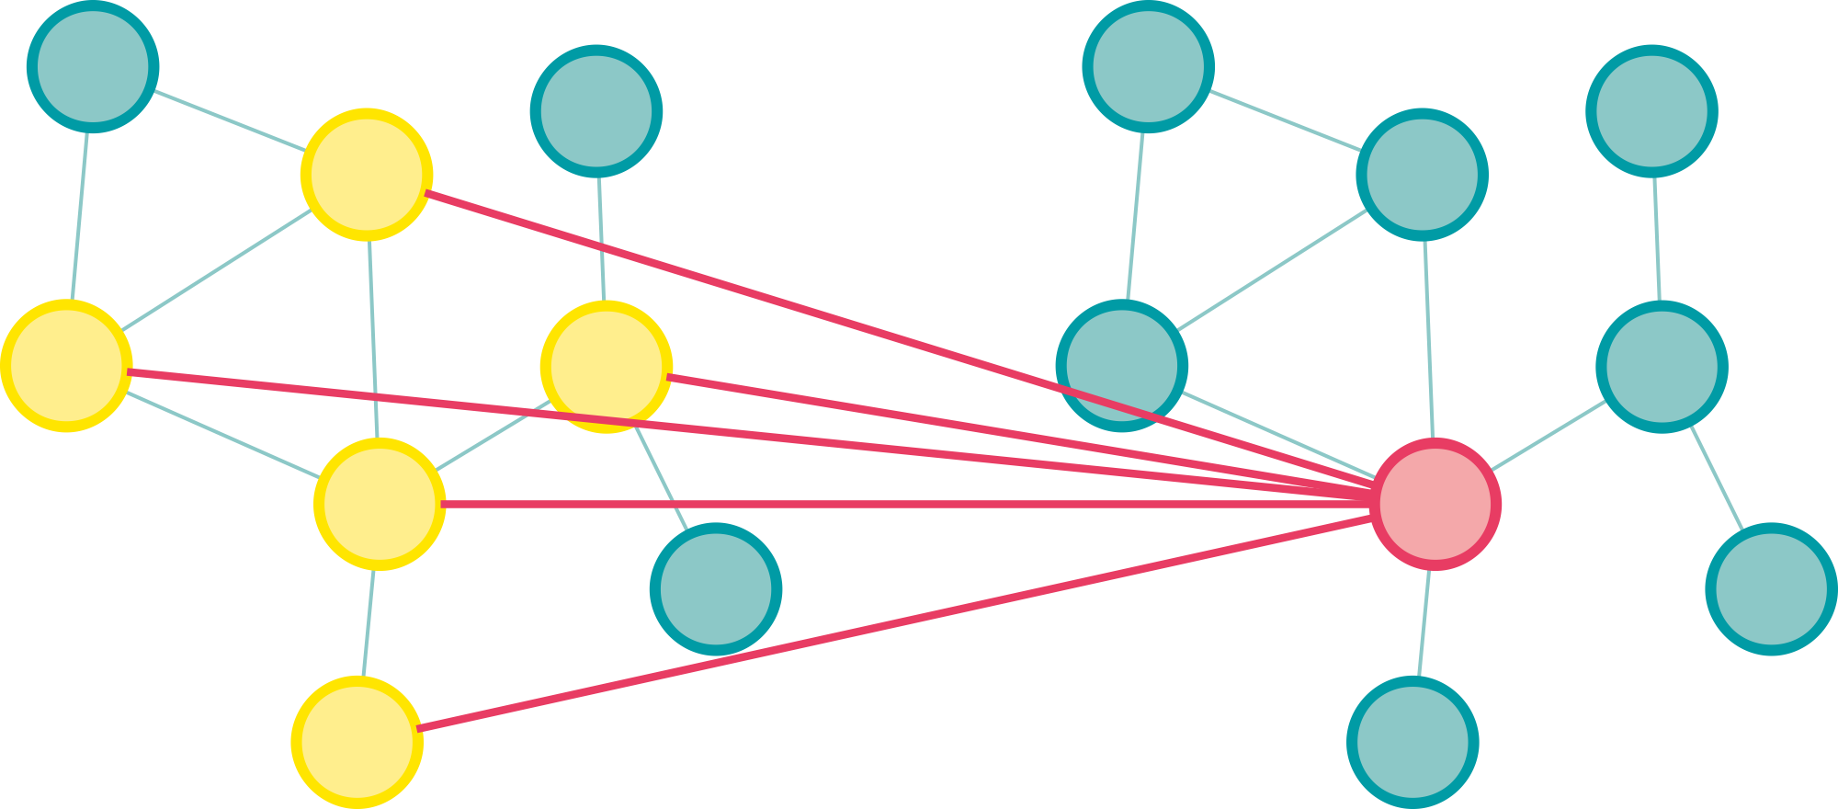
Graph layers and transformer blocks
Graph layers
Structure computation on a set (nodes) according to structure (edges)
Transformer Blocks
Dynamically induces structure from arbitrary set

Slide 9
What this workshop is
This workshop is...
a detailed dive into the GNN and Transformer architecture
practical work on implementing GNNs
opinionated about how to implement GNNs
This workshop is not...
a complete guide to modelling problems with graphs
about graph theory and graph algorithms
a guide to best practice in implementing GNNs
a tutorial on GNN frameworks like PyTorch Geometric

Slide 10
Workshop structure
The workshop is based on Jupyter Notebooks hosted on Google Colab
You will be working in small groups in breakout rooms, going through the notebooks together
We have an interactive HackMD document for asking questions and getting answers: https://hackmd.io/@enccs/SJ4OWVdVK
If you need live interaction with a tutor, come back to the main zoom room
The tutor can go back with you to your group breakout room or start a new breakout room

Slide 11
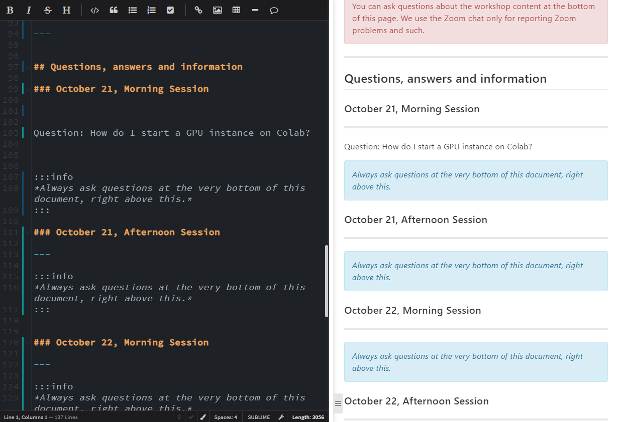
HackMD
The primary channel for asking questions
Like an editable chat with Markdown support.
You need an account to be able to edit the document

Slide 12
Google Colab
Hosted Jupyter Notebooks
Dependency management can be tricky
We use condacolab, a package for making installing an Anaconda environment on Colab very simple
However, each time you restart the colab runtime, you have to reinstall all packages
Installing PyTorch and CUDA Toolkits takes about 10 minutes, it’s best to not close the runtime

Slide 13
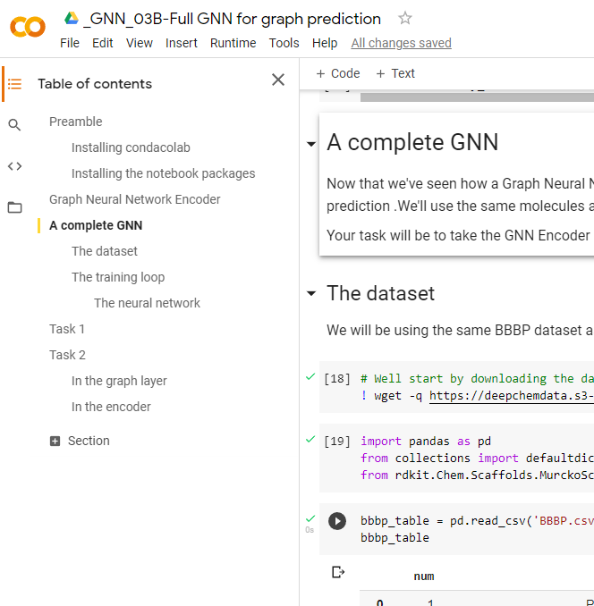
Colab Table of Contents
Many notebooks in this workshop are massive
The outline on the left of the Colab window allow you to swiftly navigate between sections of the notebook

Slide 14
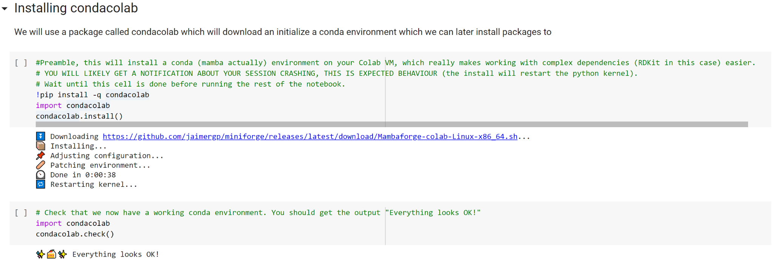
Notebooks preamble
Run this cell first
Run this after kernel has restarted

Slide 15
What is a Graph?

Slide 16
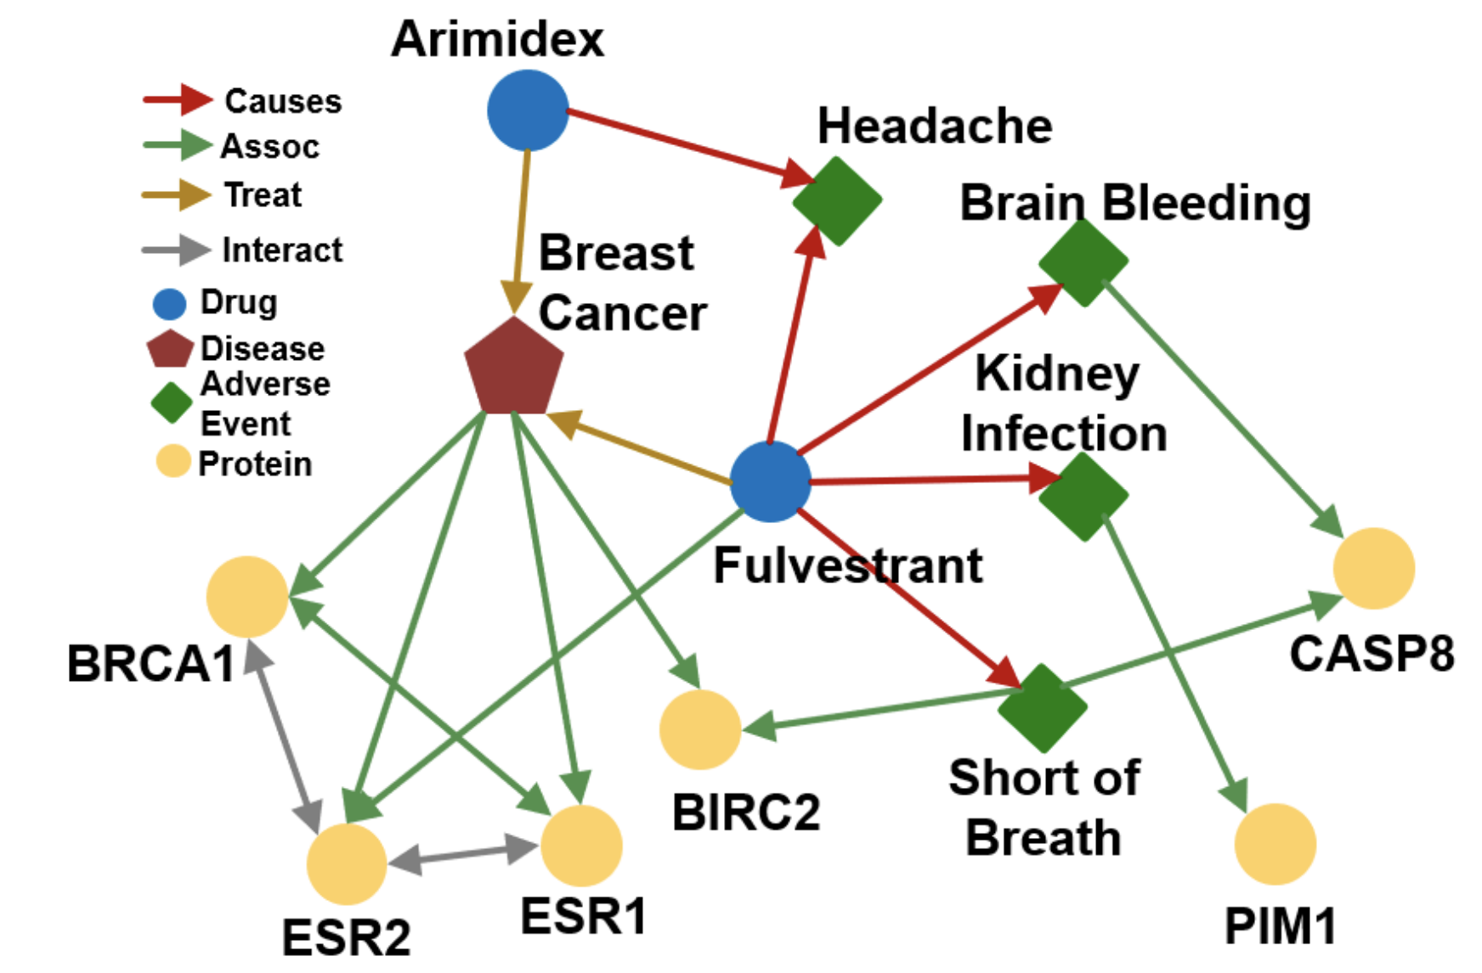
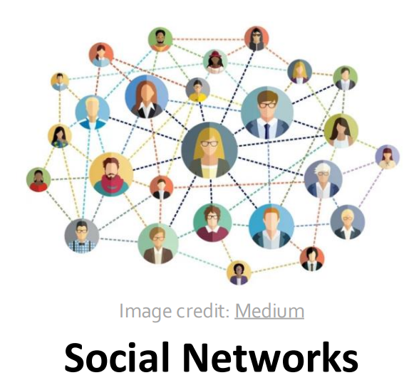
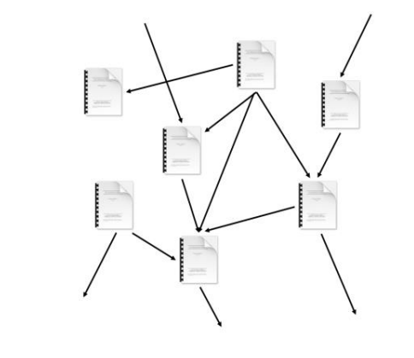
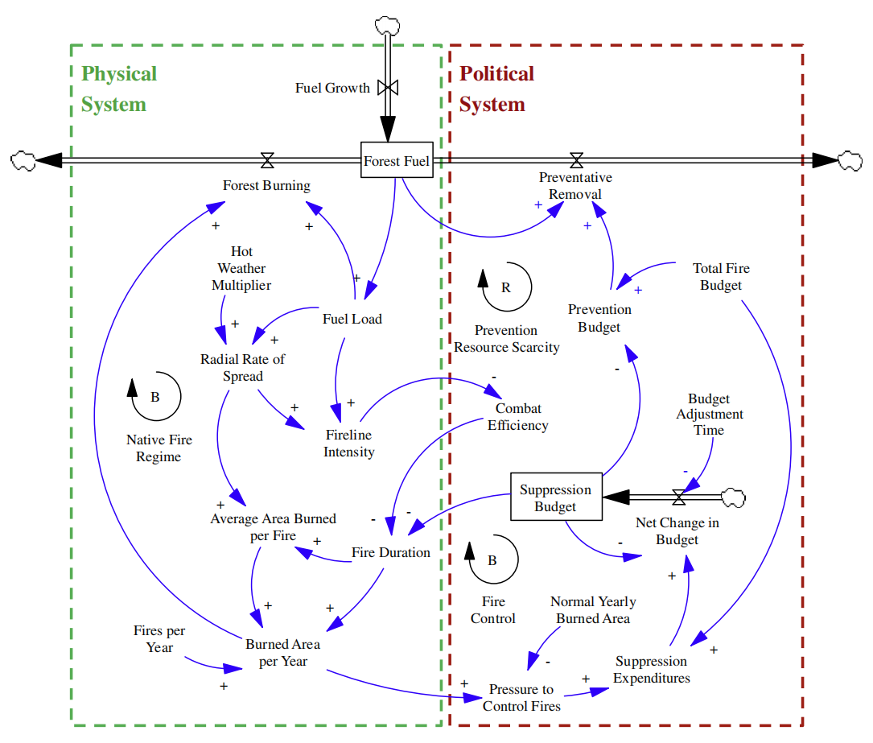
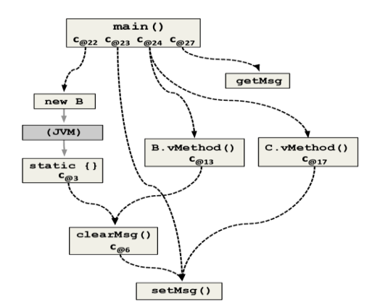
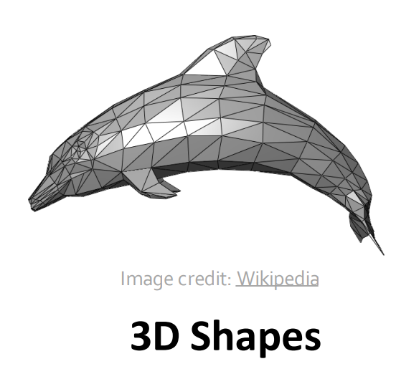

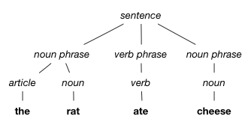
Graphs capture pairwise relationships
Knowledge Graphs
Social Networks
Citation Networks
Complex Systems
Program graphs
3D Meshes
Computer Networks
Language?
Examples from CS224W: Machine Learning with Graphs, http://web.stanford.edu/class/cs224w/

Slide 17
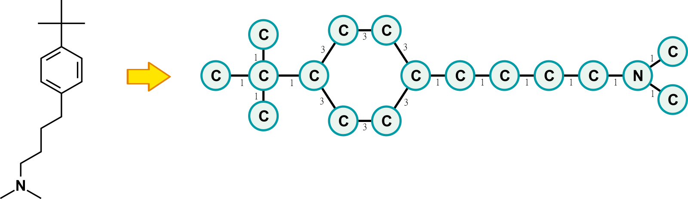
Example graphs in the workshop
Molecular structure
Graph representation

Slide 18
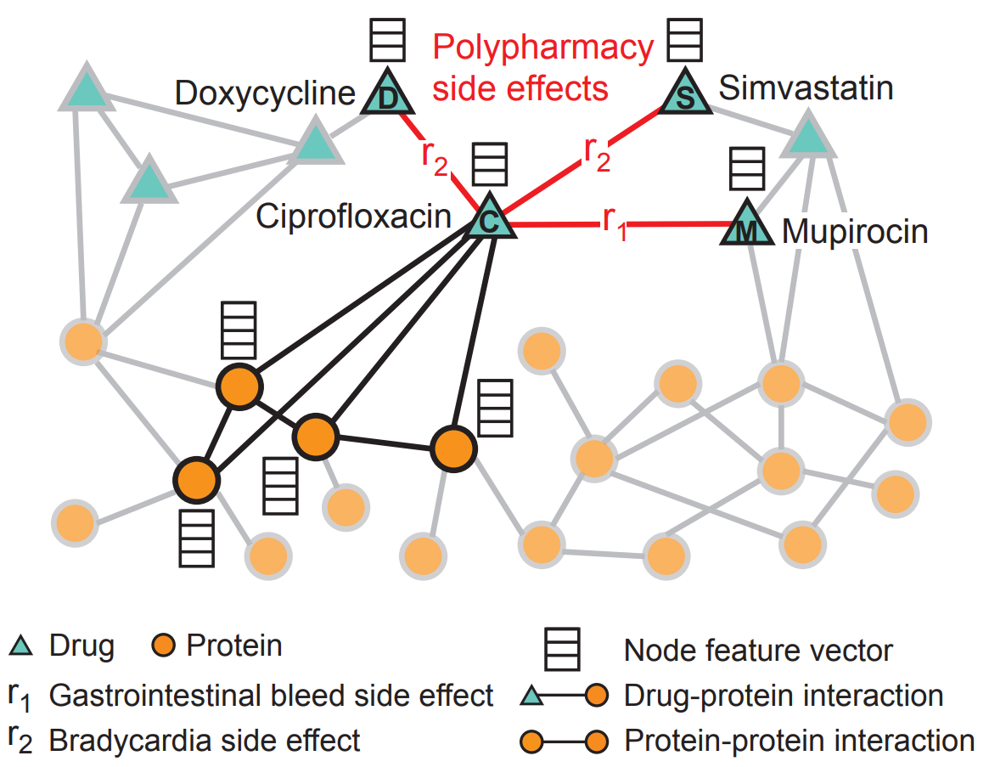
Examples of GNN applications
COMPLEX INTERACTIONS
Zitnik, Marinka, Monica Agrawal, and Jure Leskovec. "Modeling polypharmacy side effects with graph convolutional networks." Bioinformatics 34.13 (2018): i457-i466.

Slide 19
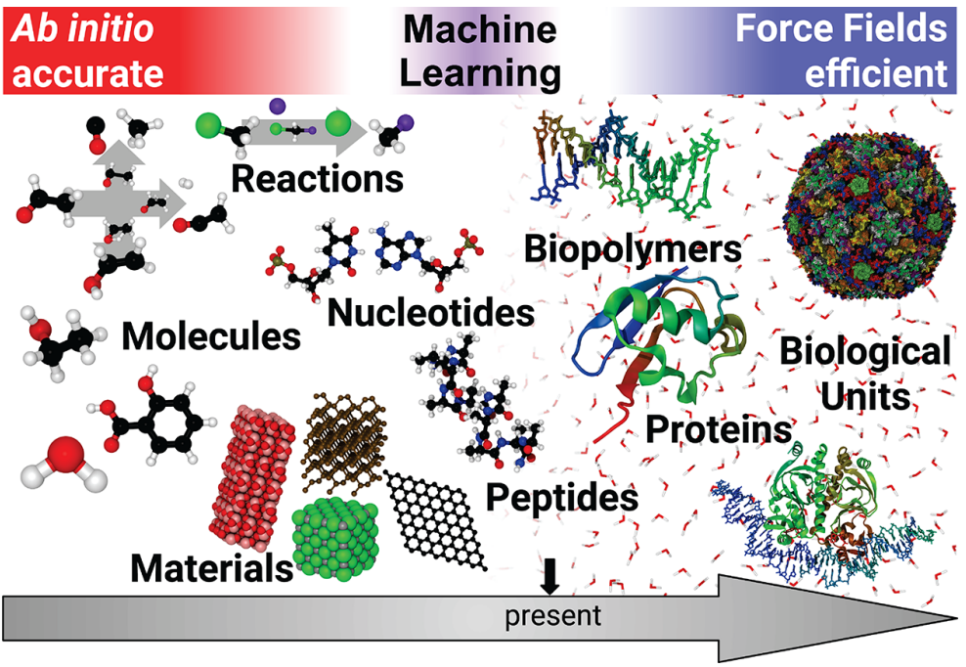
Examples of GNN applications
NEURAL NETWORK FORCE FIELDS
Unke, Oliver T., et al. "Machine learning force fields." Chemical Reviews (2021).

Slide 20
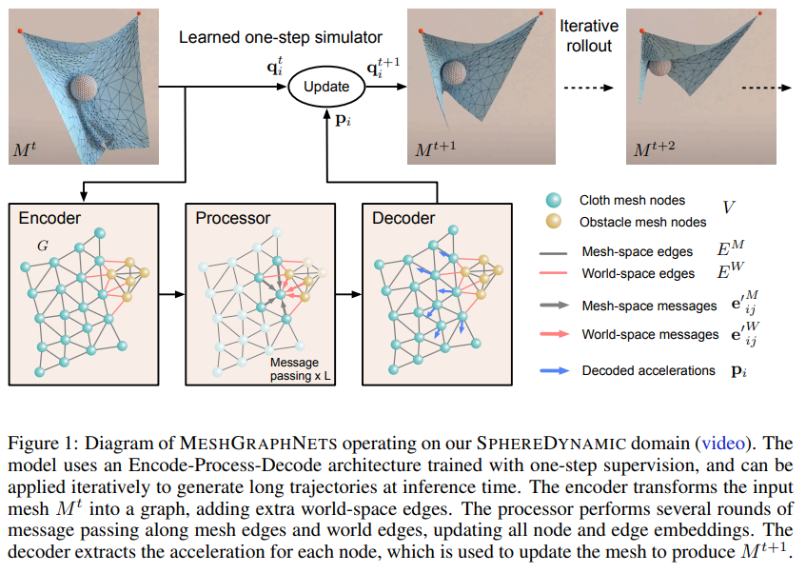
Examples of GNN applications
LEARNED SYSTEM DYNAMICS
Pfaff, Tobias, et al. "Learning mesh-based simulation with graph networks." ICLR 2021
Notes:
- NP hard problems are tried to be solved using graphs. Learned Hiuristic solution, One of the best application trying to solve really hard problems

Slide 21
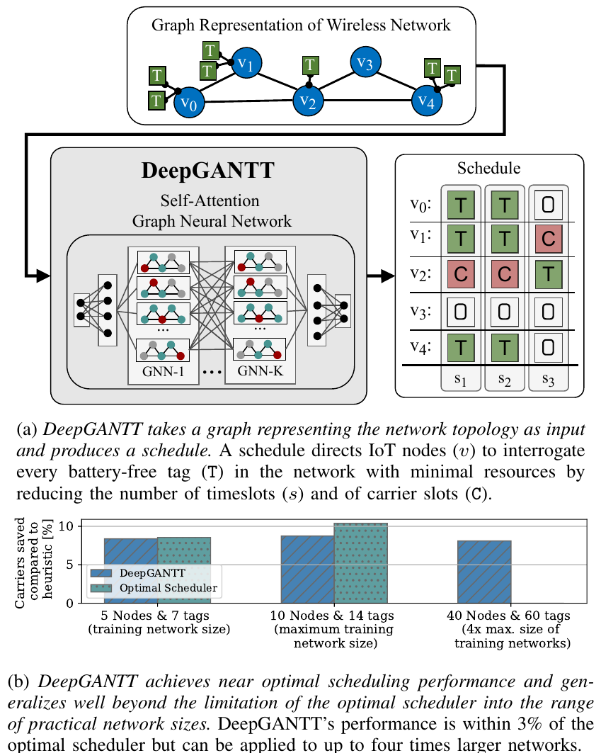
Examples of GNN applications
APPROXIMATE SOLUTIONS TO HARD PROBLEMS
To be published work by Daniel Perez, Carlos Penichet and Thiemo Voigt
Notes:
Many problems based on graphs are fundamentally difficult
Often NP-hard
With Graph Neural Networks we can learn approximate solutions

Slide 22
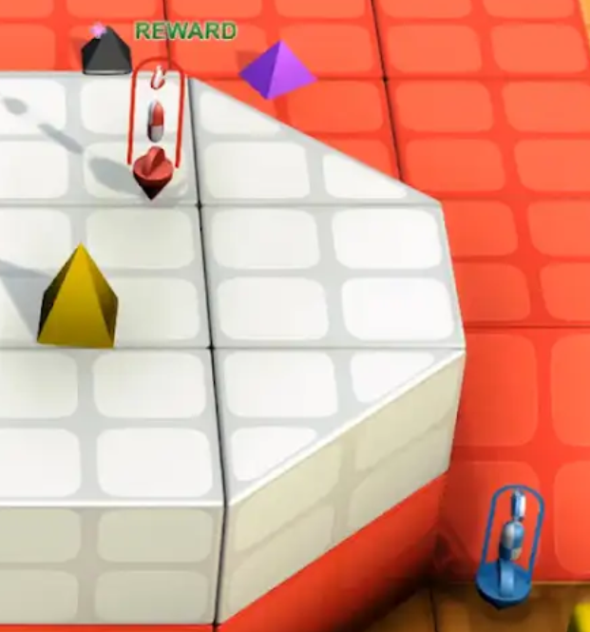
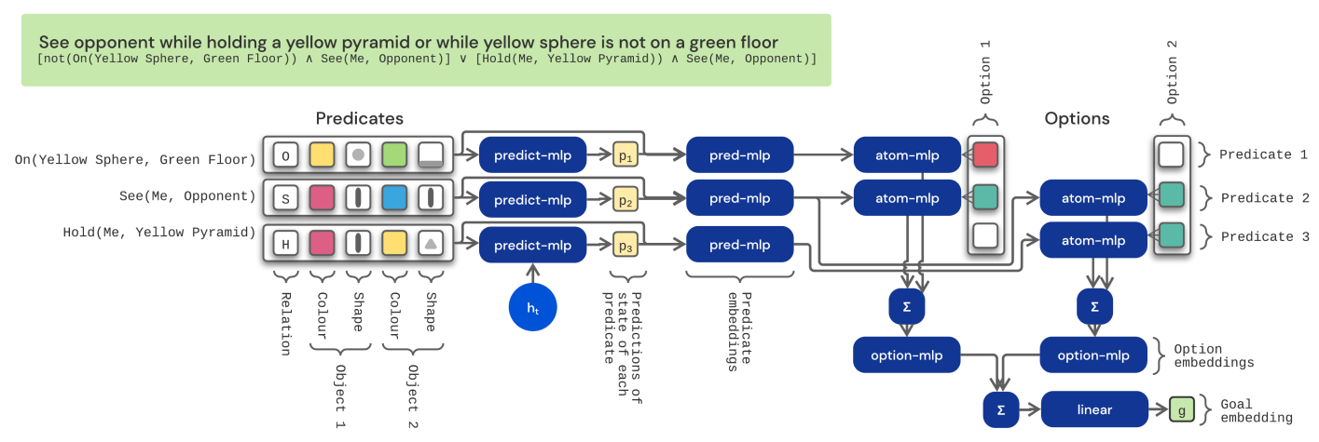
Examples of GNN applications
EMBEDDING LOGICAL PROPORTIONS
DeepMind Open-ended Learning Team. "Open-ended learning leads to generally capable agents." arXiv preprint arXiv:2107.12808 (2021).
https://deepmind.com/research/publications/2021/open-ended-learning-leads-to-generally-capable-agents
Notes:
- Embed logical propositions using graph neural netoworks.

Slide 23
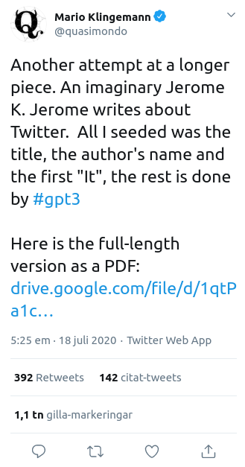
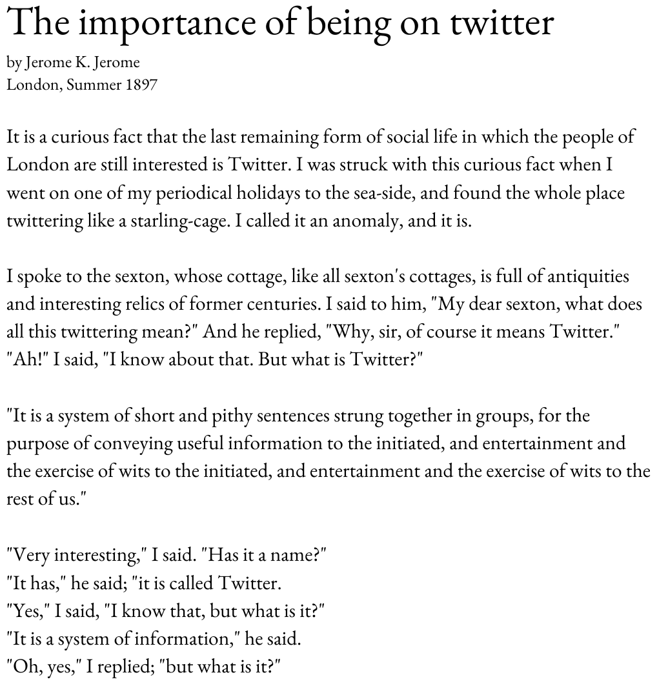
Examples of Transformer applications
GPT-3
https://twitter.com/quasimondo/status/1284509525500989445?s=20
Notes:
- Transformer is not a sequence model, it is a model that works on sets.

Slide 24
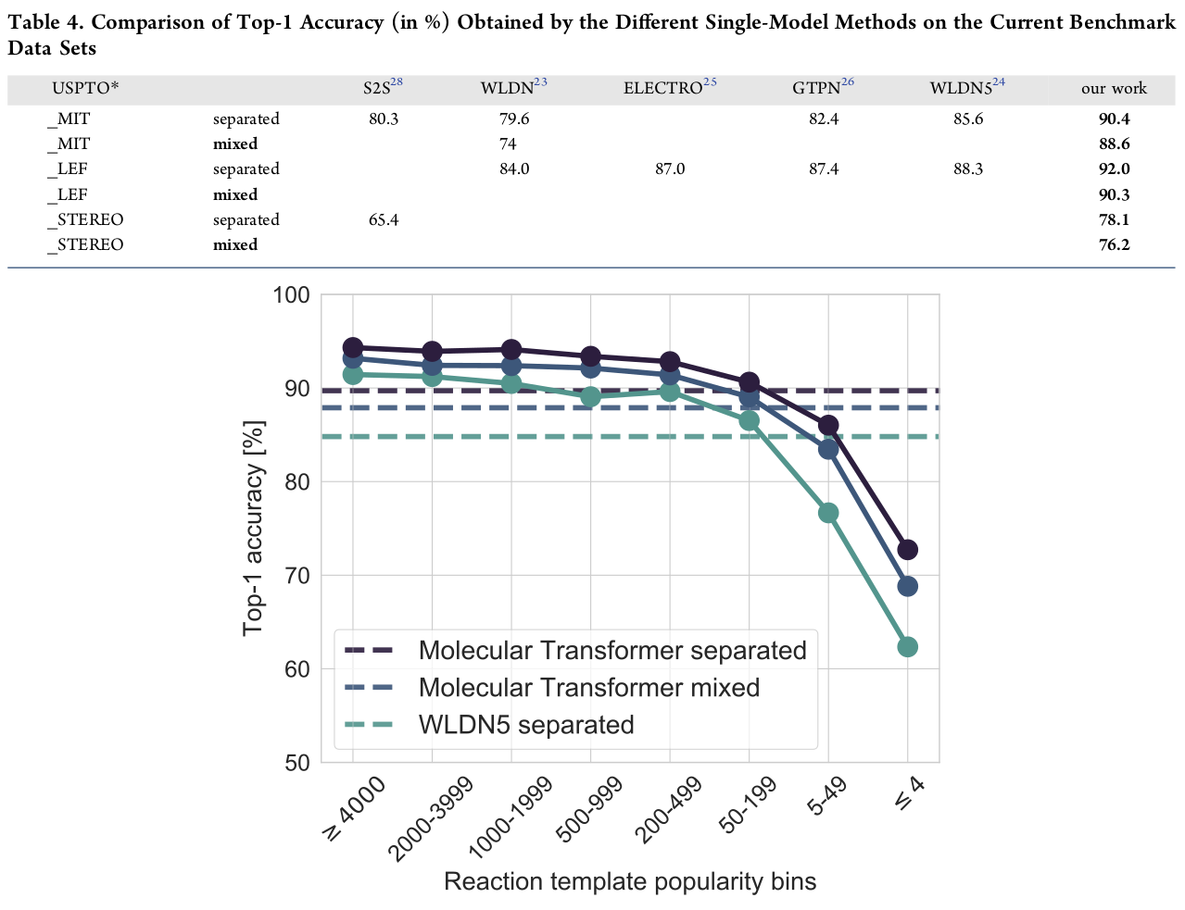
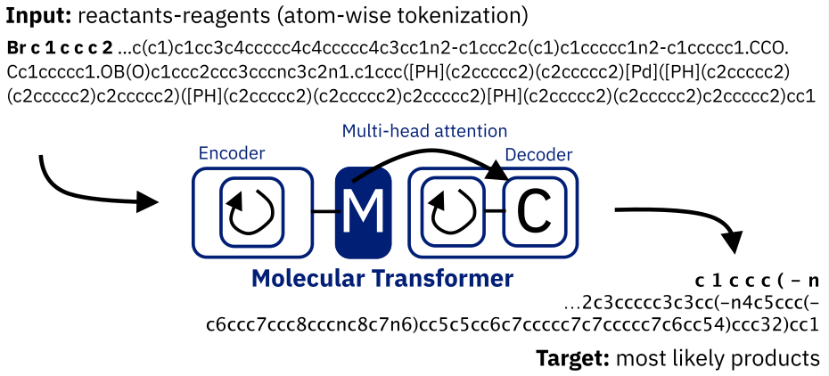
Examples of Transformer applications
REACTION PREDICTION
Schwaller, Philippe, et al. "Molecular transformer: A model for uncertainty-calibrated chemical reaction prediction." ACS central science 5.9 (2019): 1572-1583.
Notes:
- Take the graph of molecule and linearize it.

Slide 25
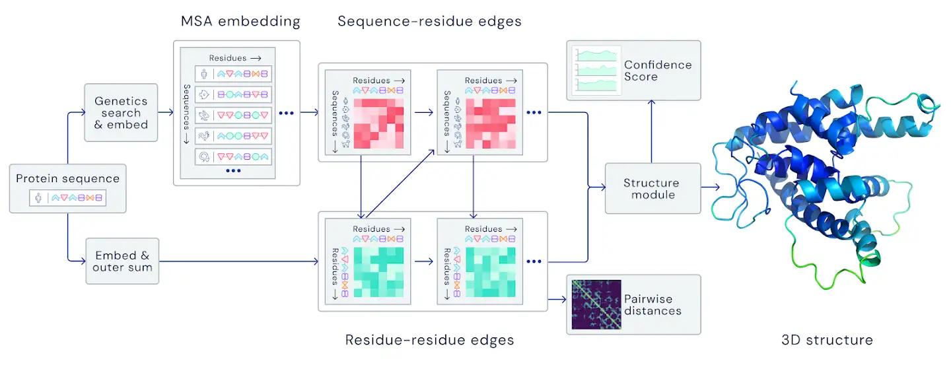
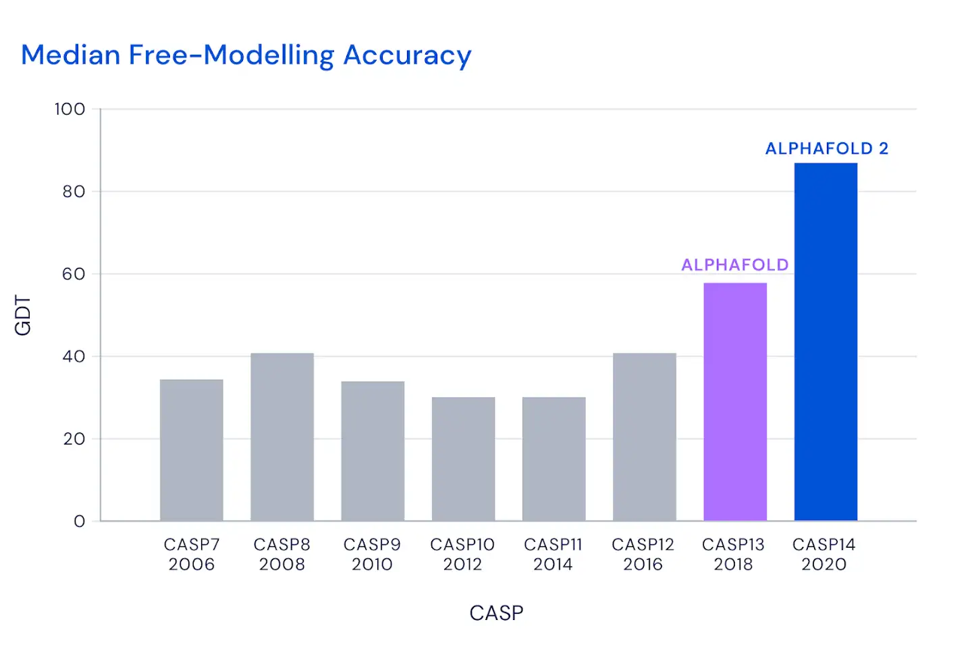
Examples of Transformer applications
PROTEIN FOLDING
https://deepmind.com/blog/article/alphafold-a-solution-to-a-50-year-old-grand-challenge-in-biology
RISE — Research Institutes of Sweden
Notes:
- Alphabet contributed good progress here. Look for pairwise relation not only graphs.

Slide 26
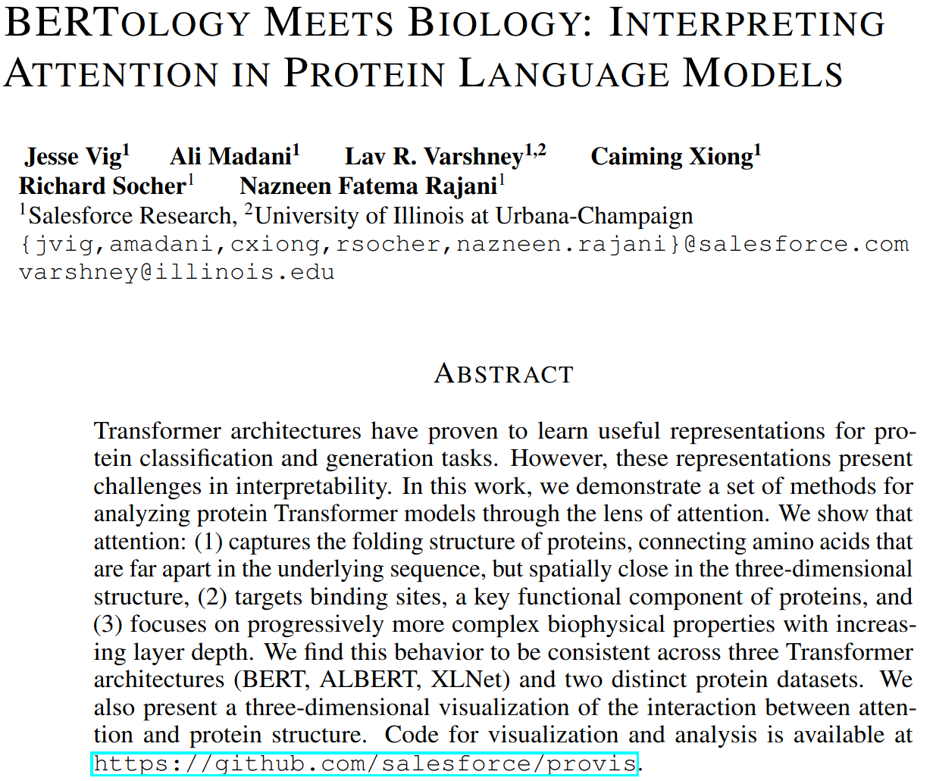
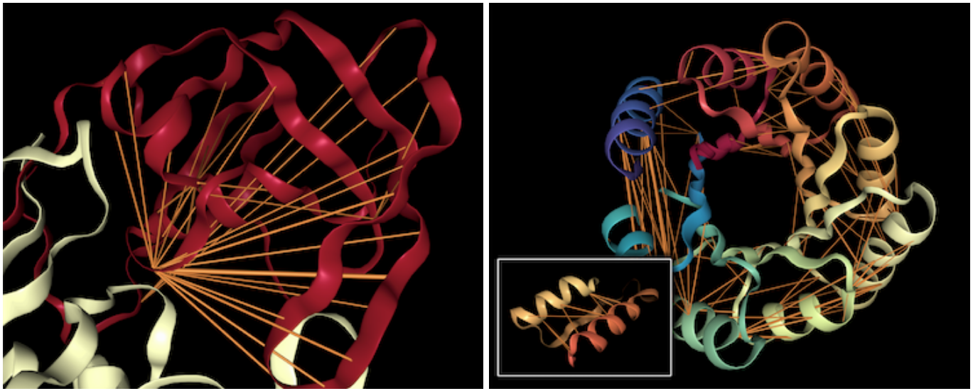
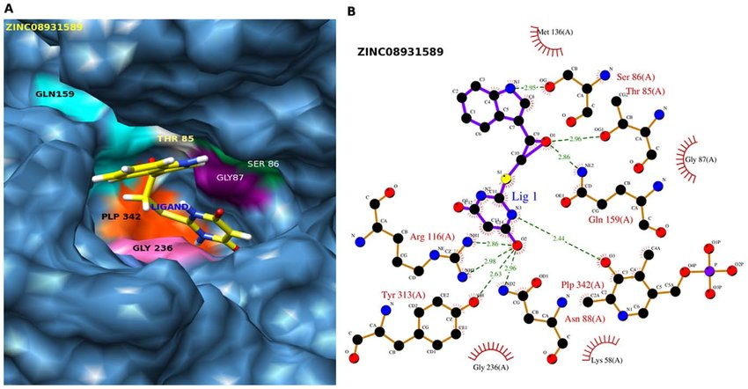
Examples of Transformer applications
CURIOUS PROTEIN SEMANTICS
https://arxiv.org/abs/2006.15222

Slide 27
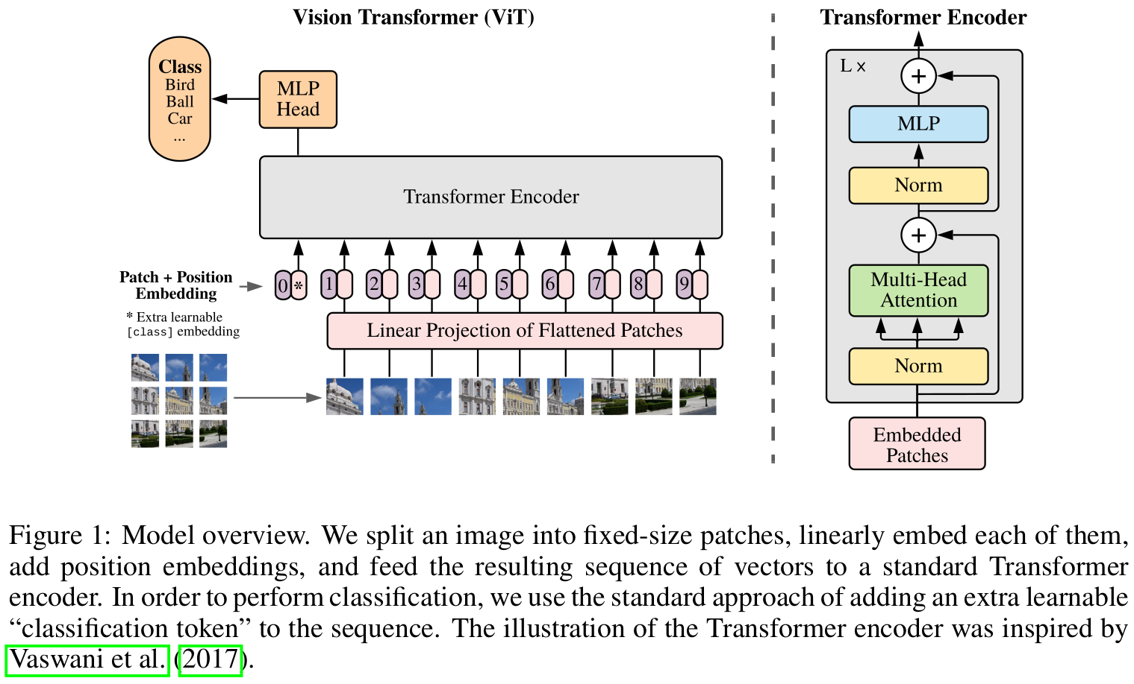
Examples of Transformer applications
COMPUTER VISION
Dosovitskiy, Alexey, et al. "An image is worth 16x16 words: Transformers for image recognition at scale." arXiv preprint arXiv:2010.11929 (2020).
Notes:
The same or even better performance than convolutional neural networks.

Slide 28
Graph basics

Slide 29
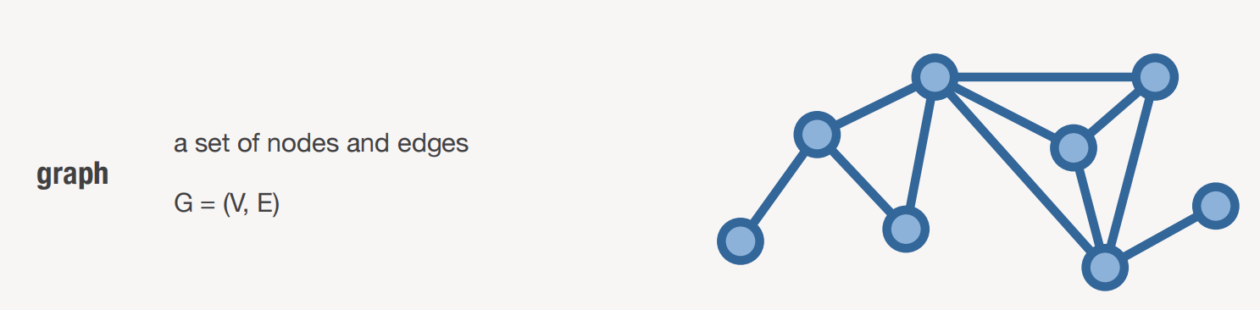

Slide 30
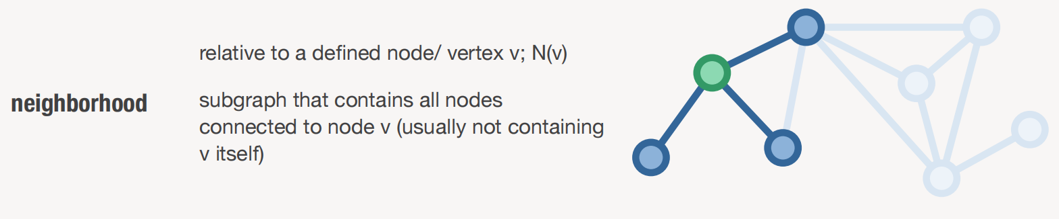

Slide 31
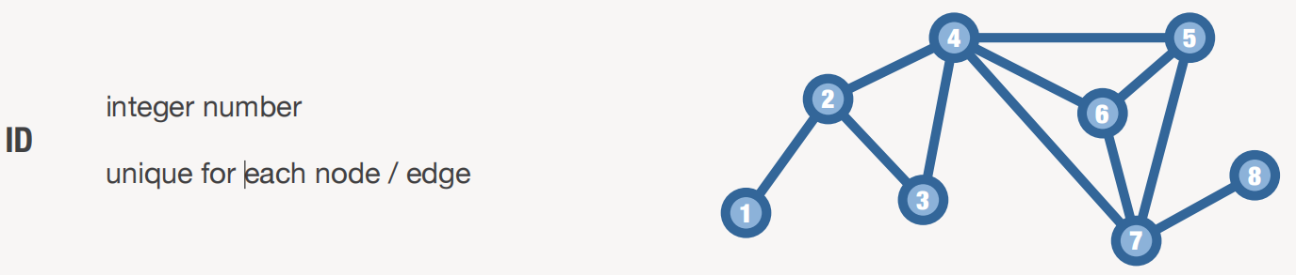

Slide 32
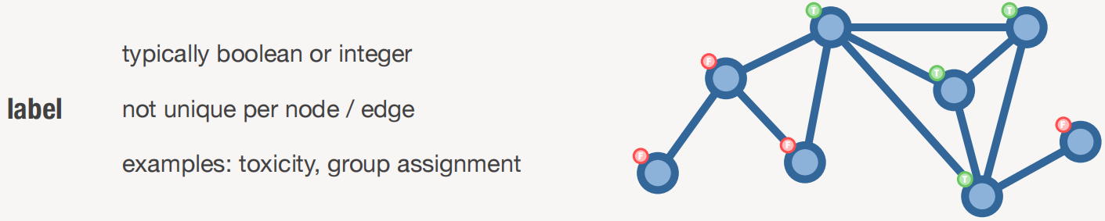

Slide 33
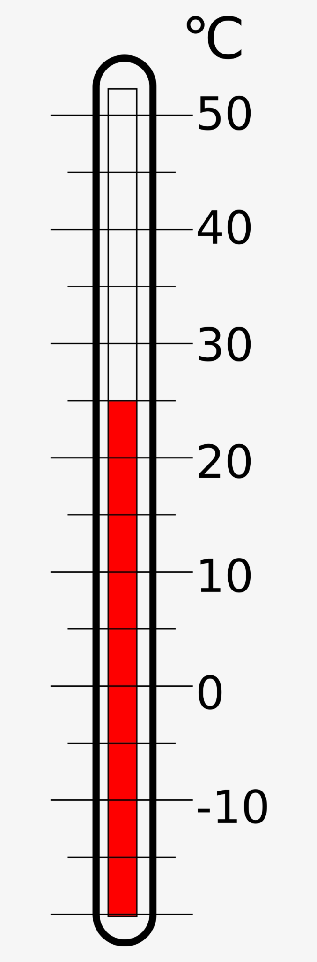
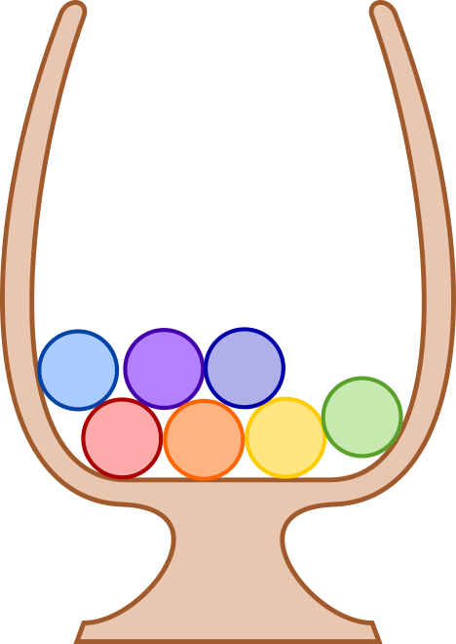
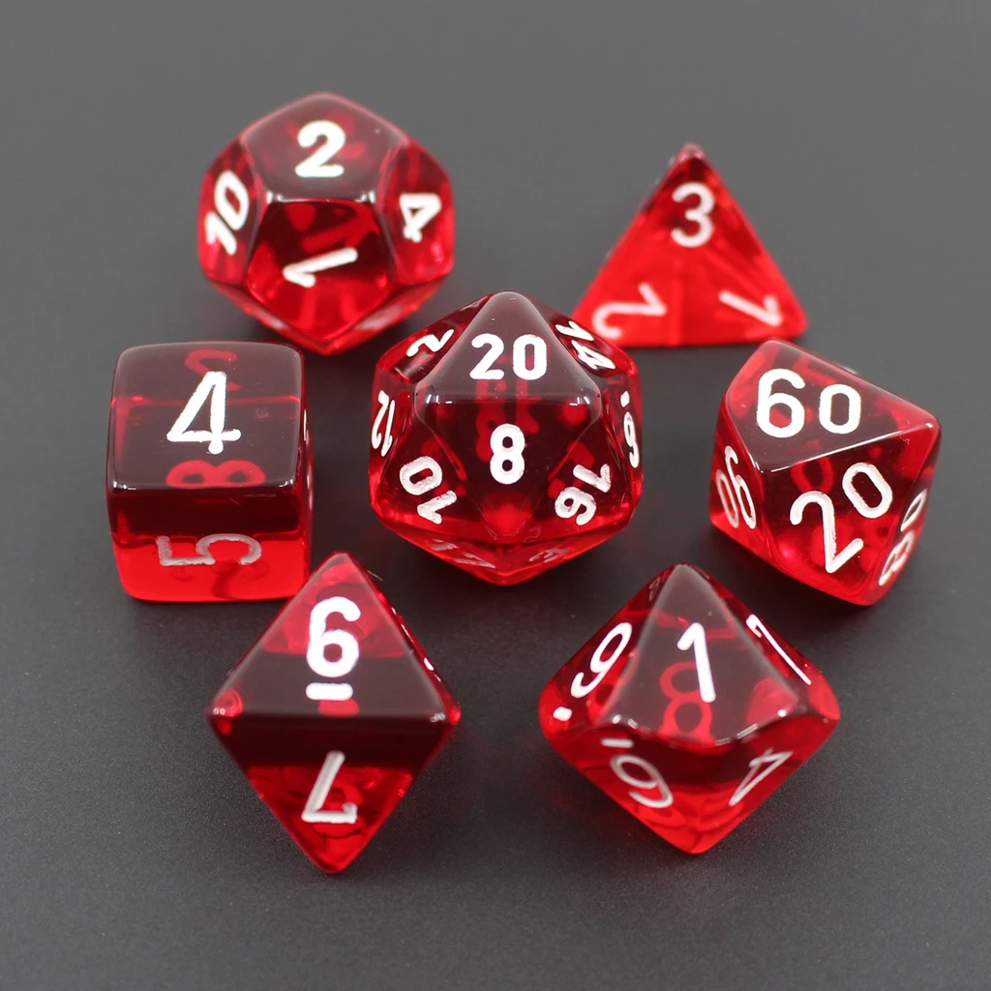
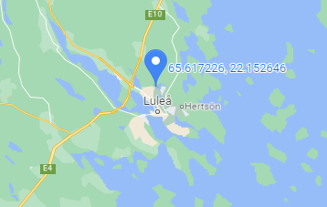
Variable types
Discrete
Takes one of a finite set of values
We will mainly treat (and call) these as categorical
Continuous
Takes any value from an infinite set of values

Slide 34
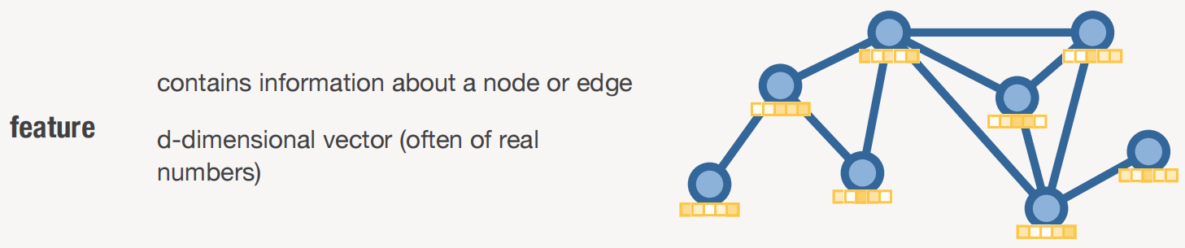

Slide 35
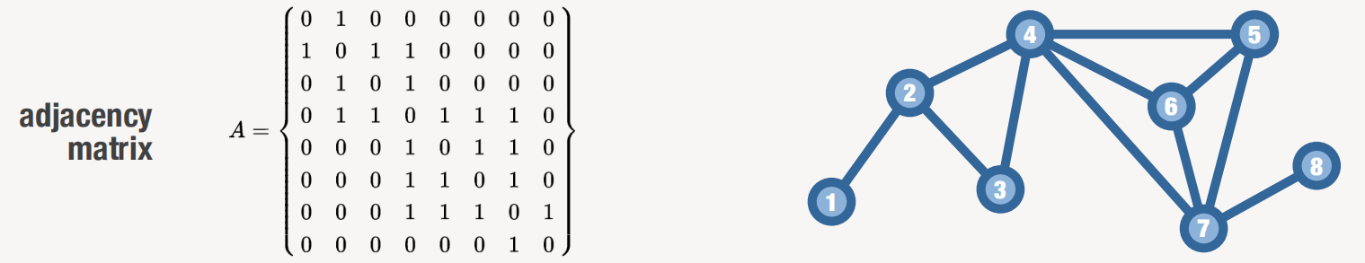
Notes:
First row corresponds to first node etc…
We can see that the relationship is semetric. This are sparse representations. Only represent the parts which have 1 not zeros.

Slide 36
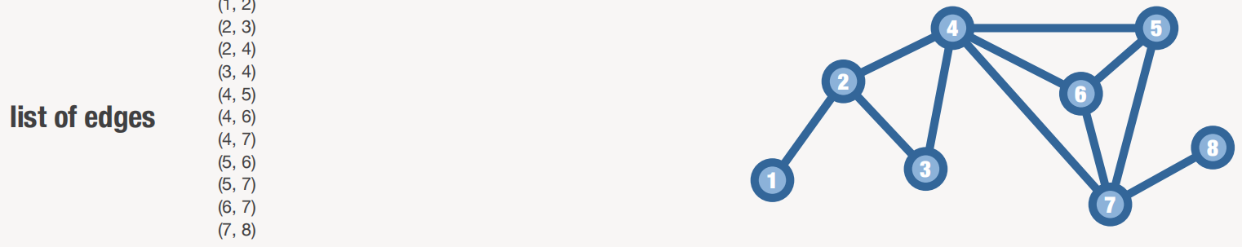

Slide 37
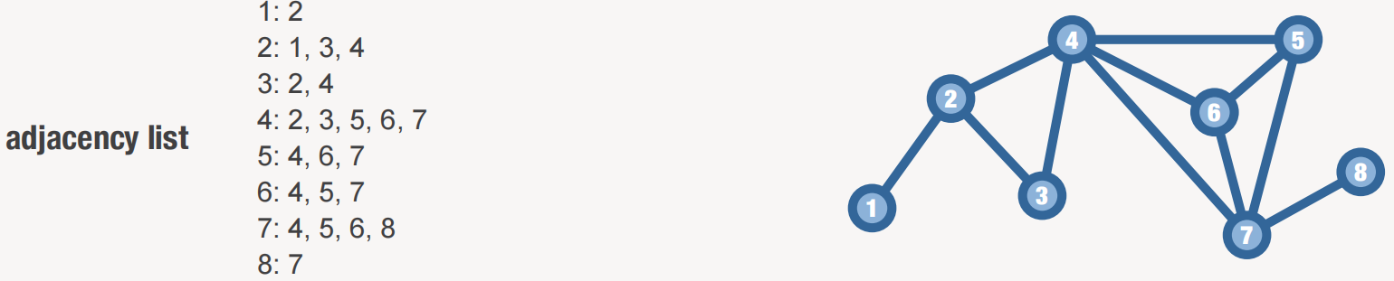

Slide 38
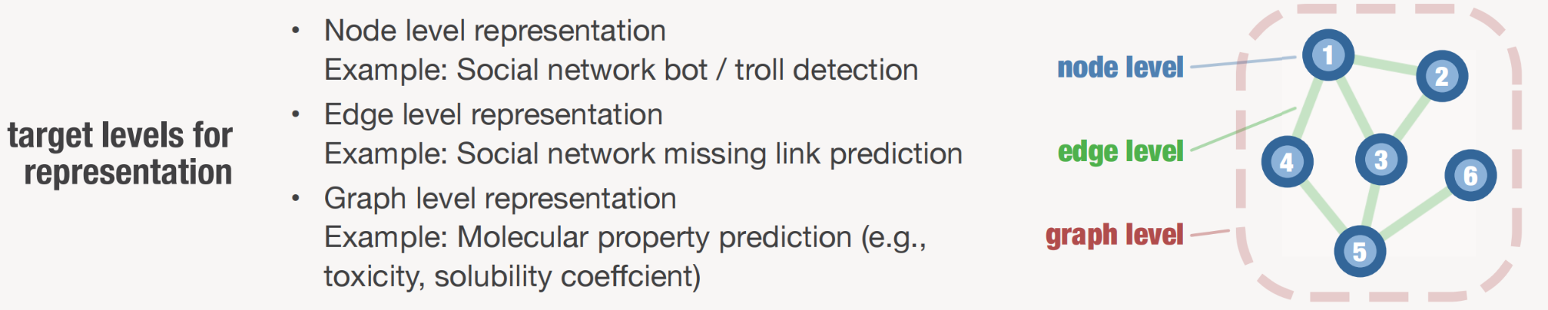

Slide 39
Learning on graphs - transductive vs. inductive
Transductive - learning on a fixed graph, generalizing from one part of the graph to another.
Node clustering, node classification for social network analysis
Link prediction for recommender system
Inductive (our focus) - Learning from one graph, generalizing to another
Graph property prediction for molecular property prediction
Neural force fields

Slide 40
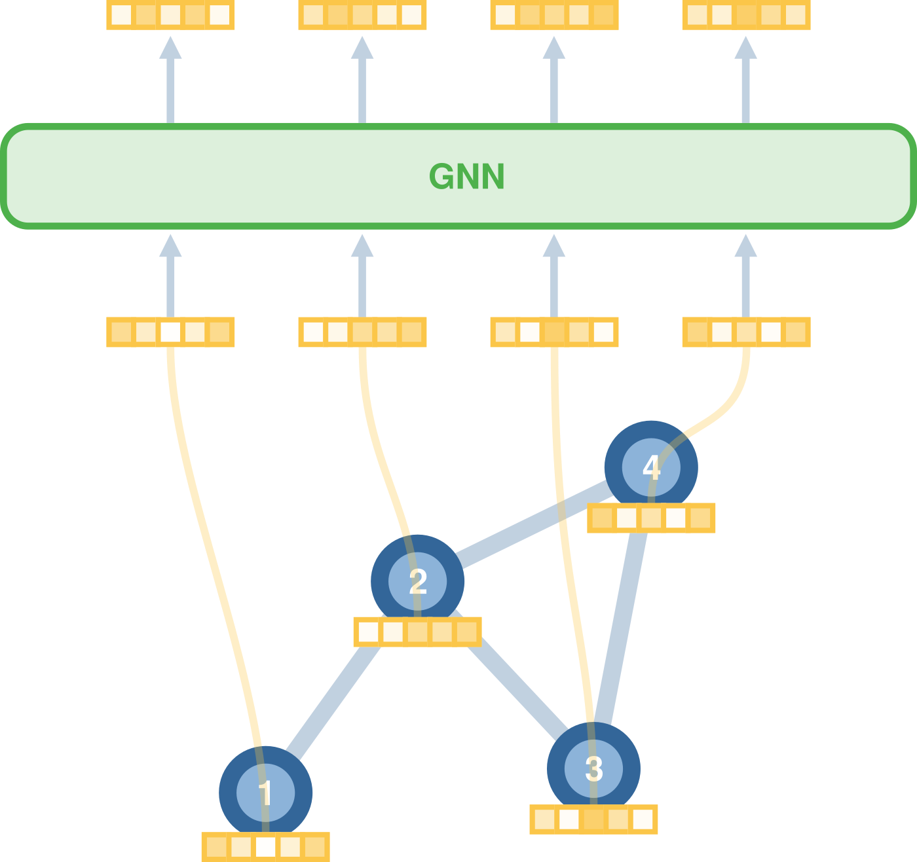
Inductive graph learning
Graph Neural Network overview

Slide 41
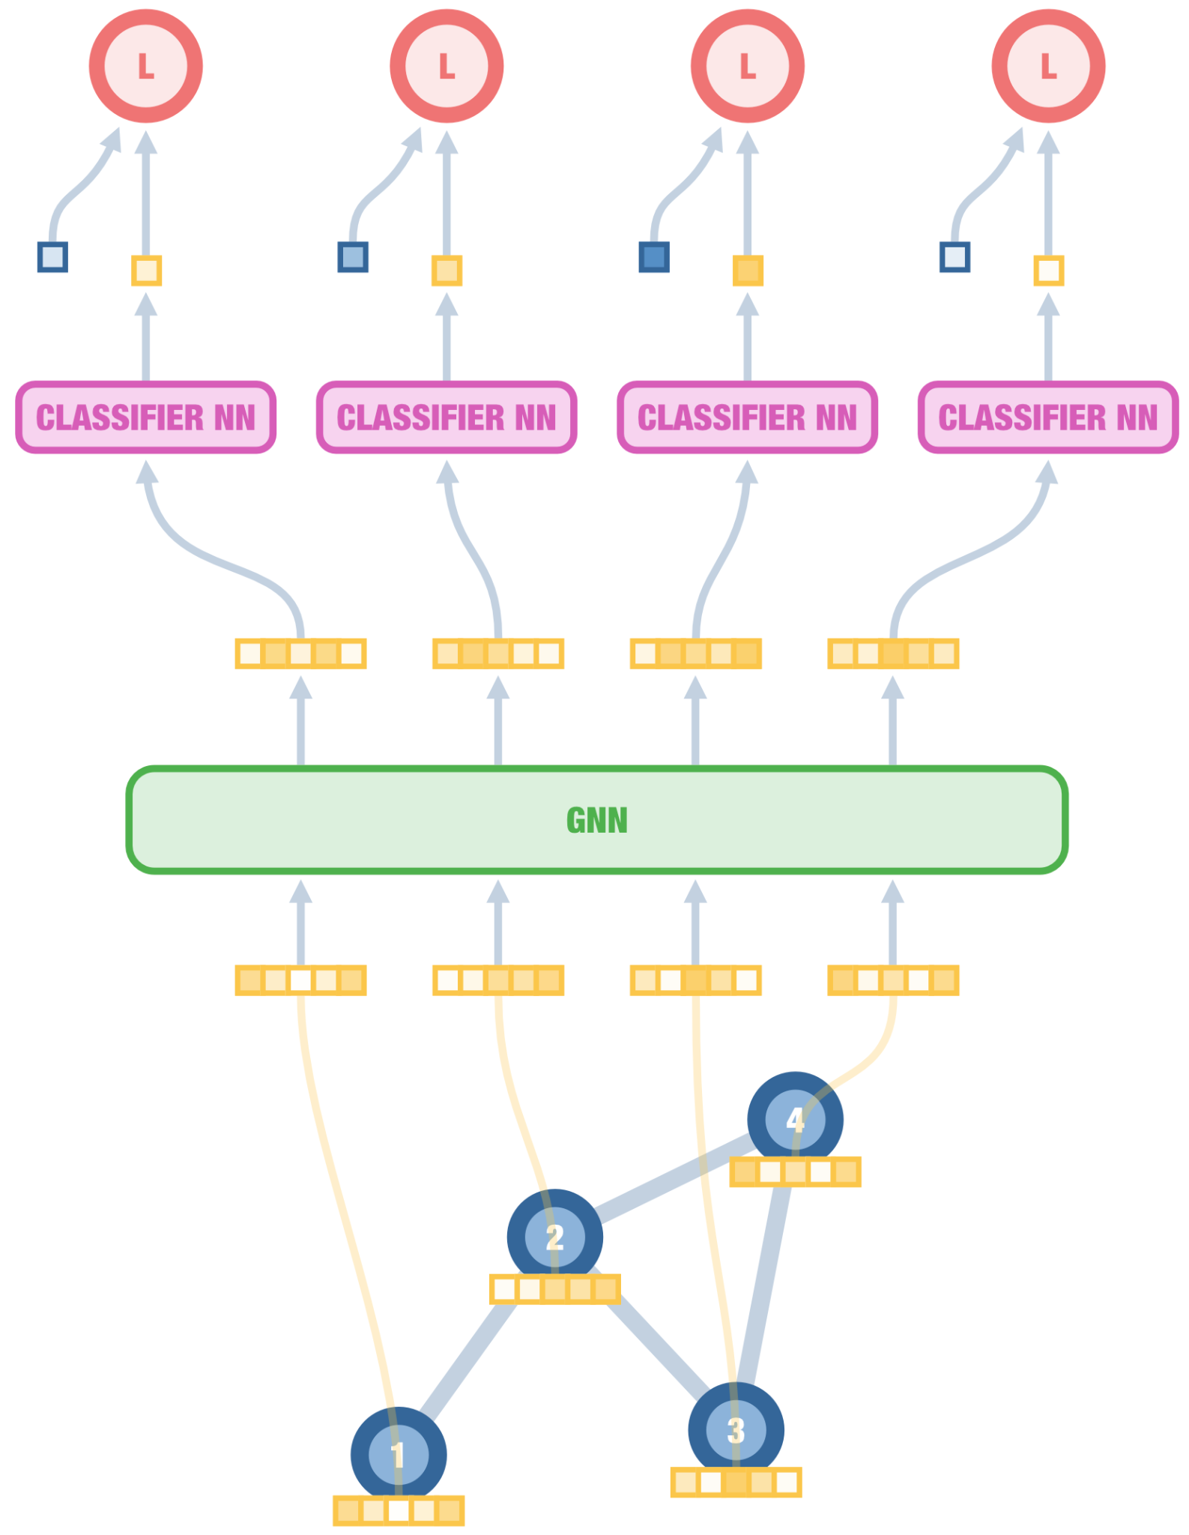
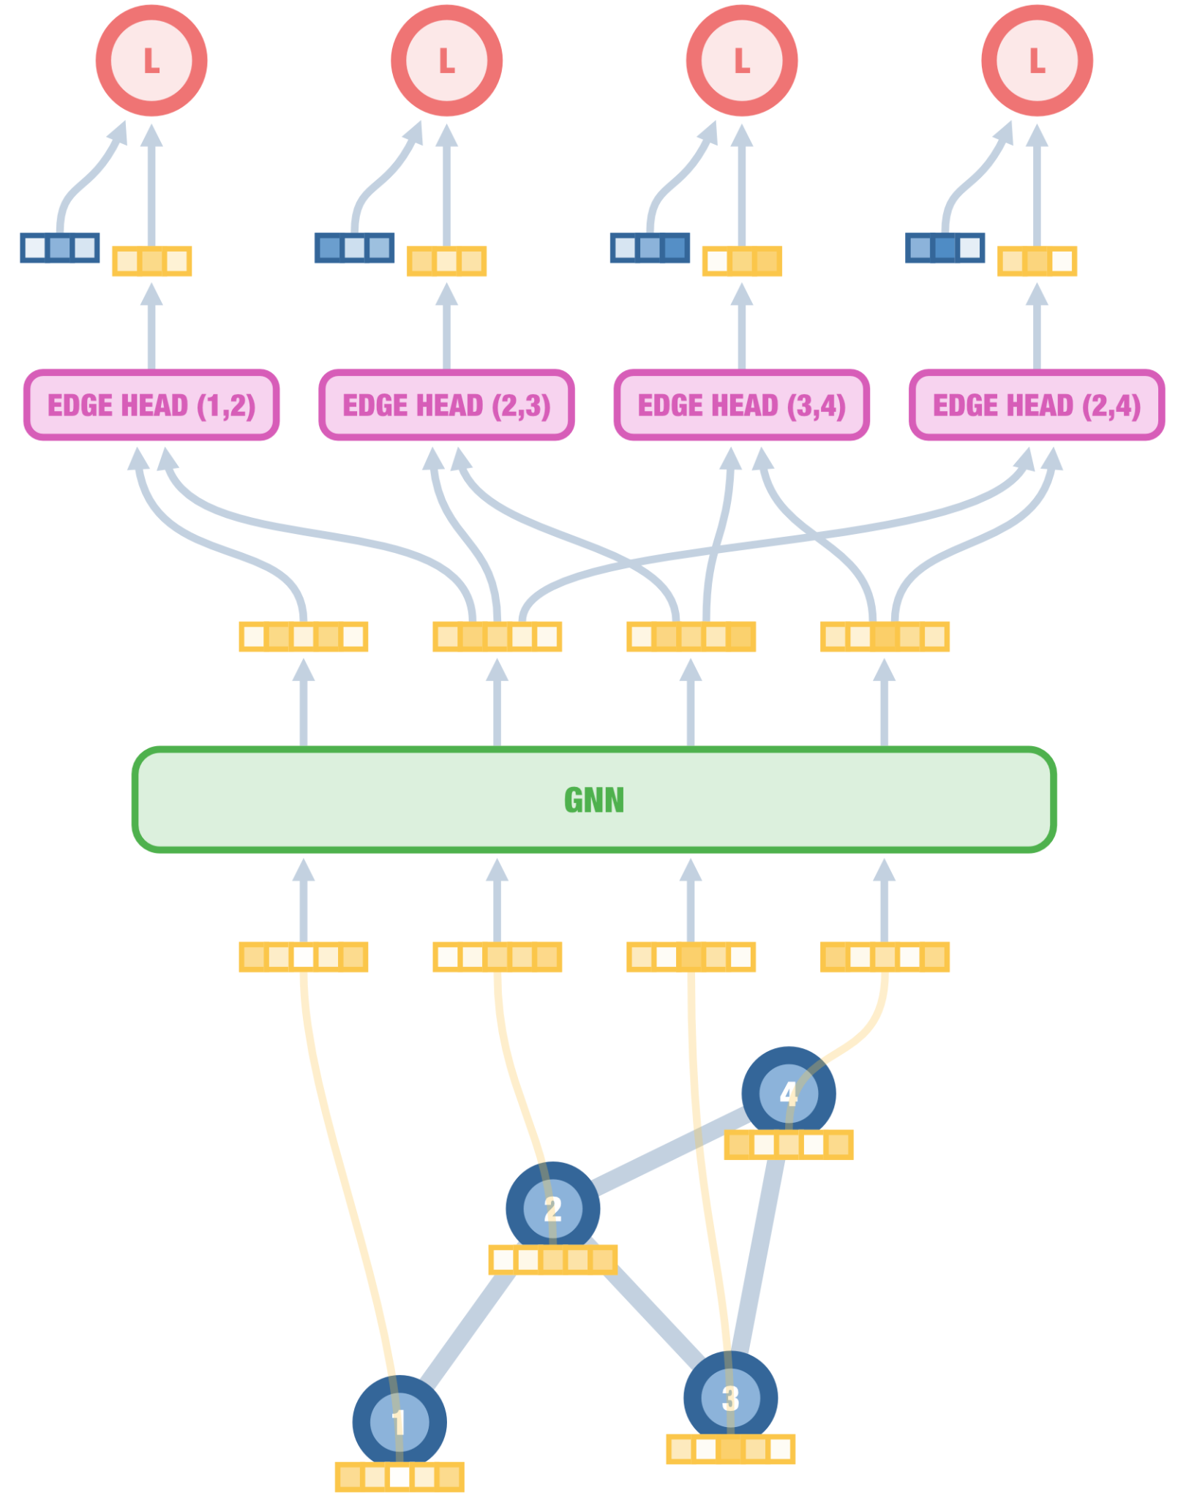
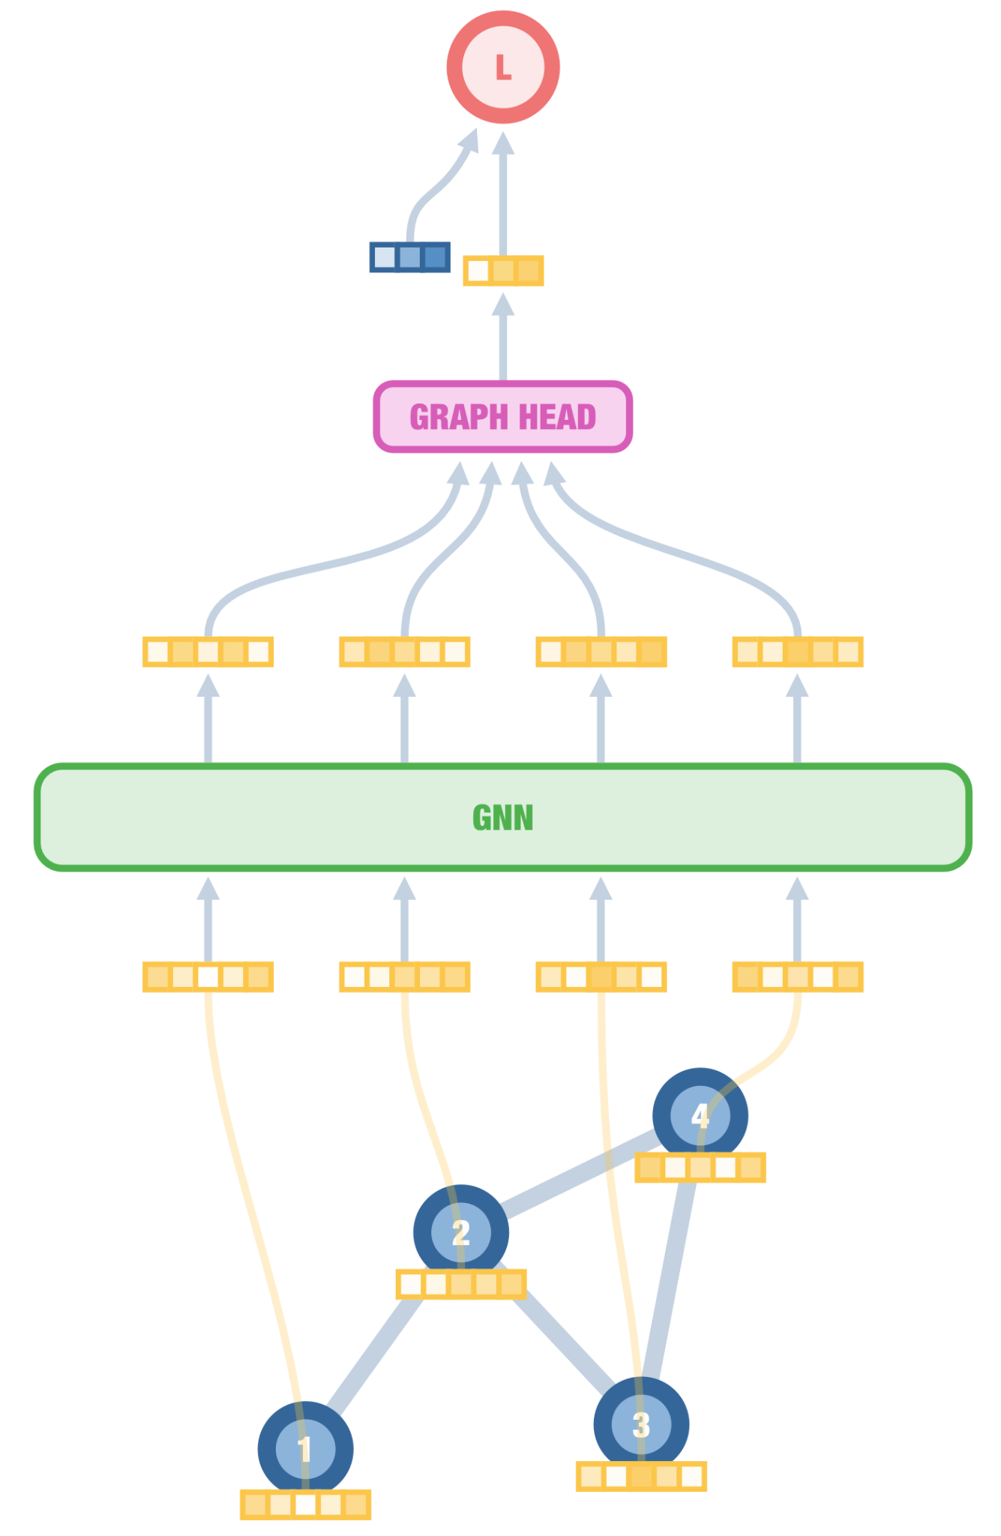
Inductive graph learning
Three levels of granularity
Node prediction
User role in social network
Edge/pair prediction
Pairwise forces in a neural force field
Graph prediction
Molecular property prediction

Slide 42
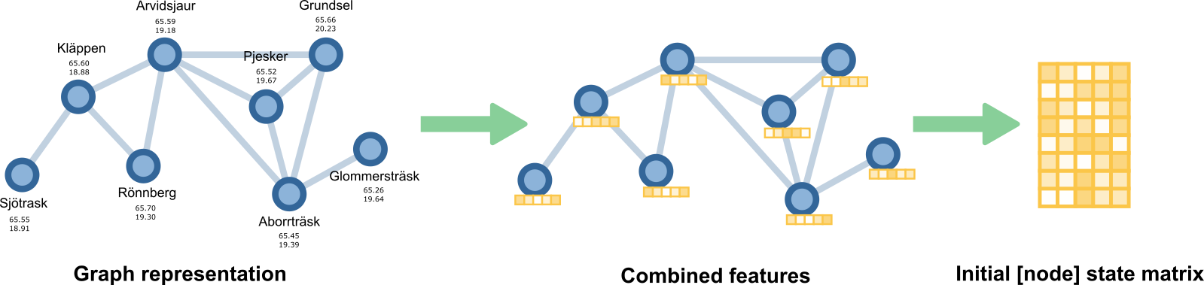
From graphs to arrays
SESSION 1
Notes:
- Change it to vector / vectorize it to single feature vector. Finally we have feature metrix.

Slide 43
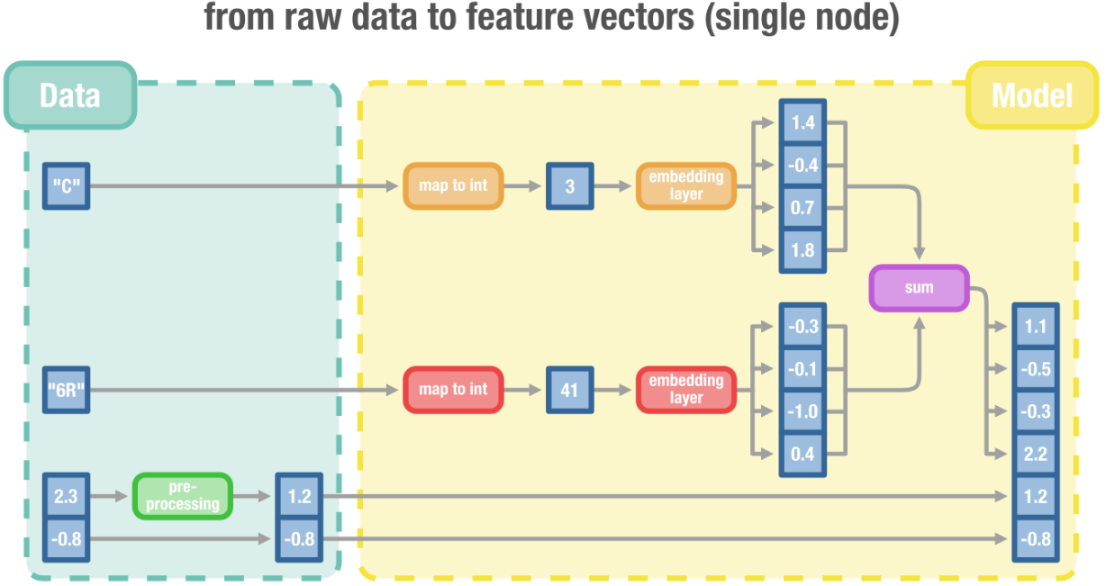
From graphs to arrays
SESSION 1
Notes:
- Embedding layer, encodings are used instead of one hot vectors which is advised to be avoided when using neural networks. Avoid one hot encodings.

Slide 44
Thank you!
enccs.se

